Slide 1



Web and Internet
Class VI
lab 7

Slide 2
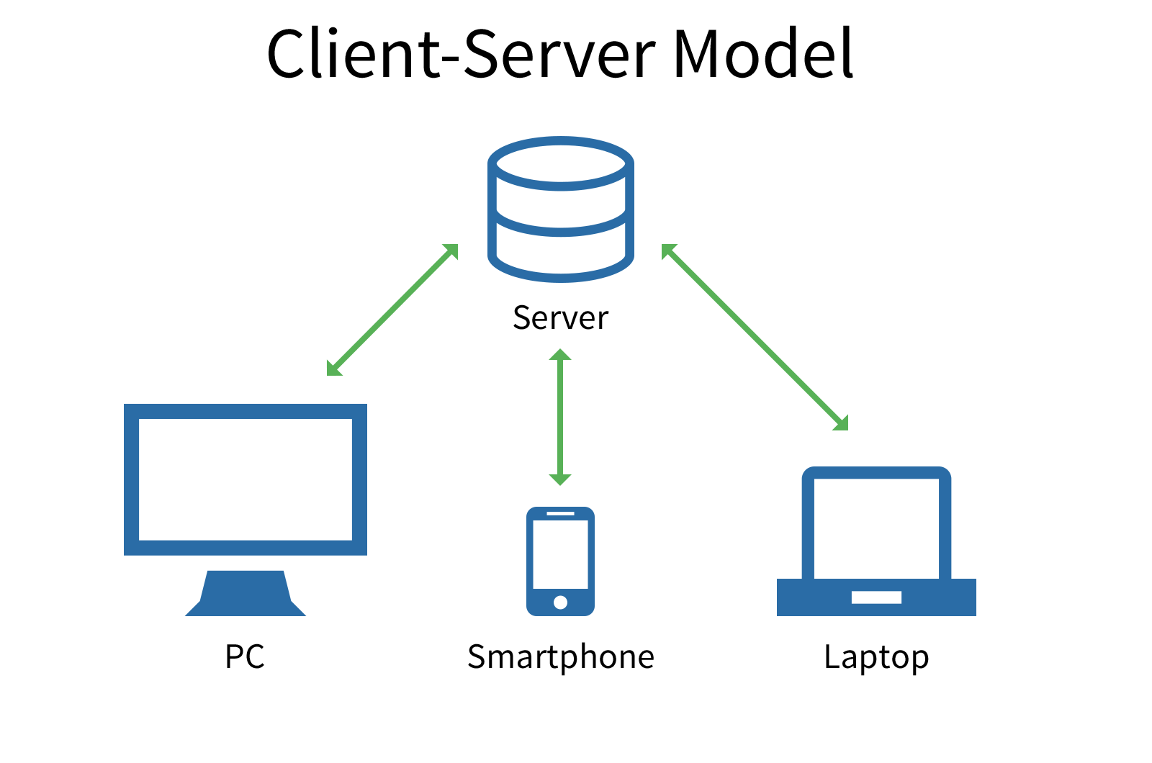
Client Server Model
a distributed application structure

Slide 3

Client
computer hardware device or software that accesses a service made available by a server

Slide 4
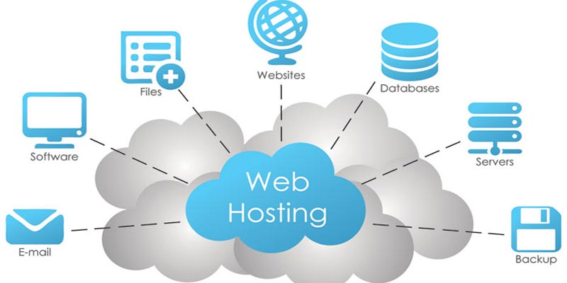
Server
A host is a computer, connected to other computers for which it provides data or services over a network

Slide 5
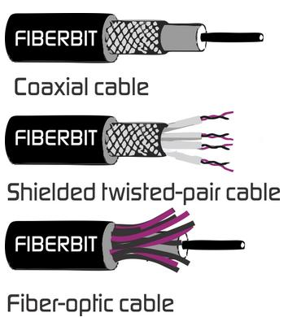
IP Address
Media refers to the communication channels used to interconnect nodes on a computer network

Slide 6
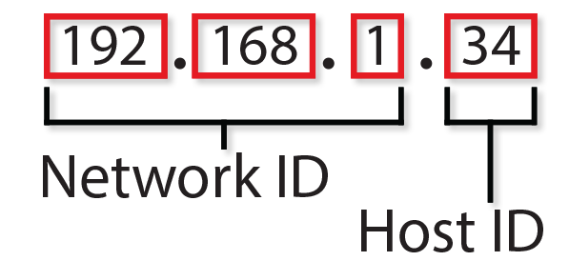
IP Address
An Internet Protocol address is a numerical label assigned to each device connected to a computer network

Slide 7
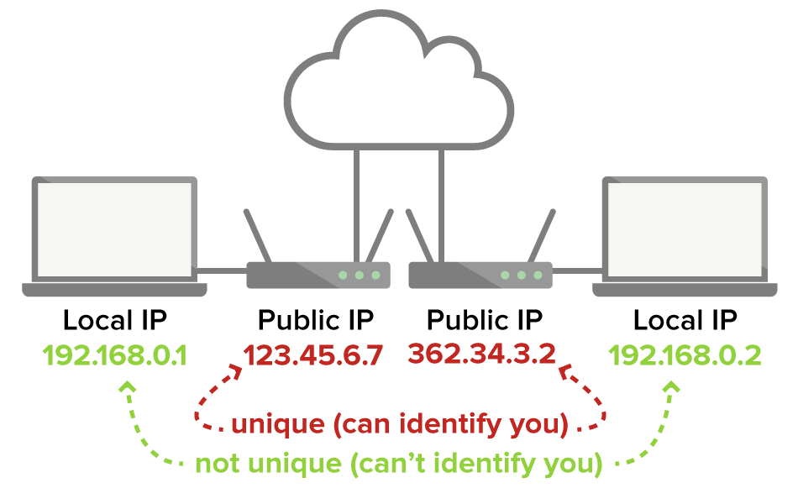
Public vs Private IP

Slide 8
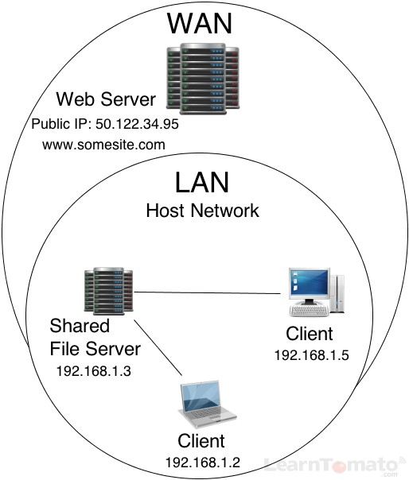
Accessing a Server

Slide 9


